Slide 1
Like to vs. would like to
Basic 07 – Unit 7a

Slide 2
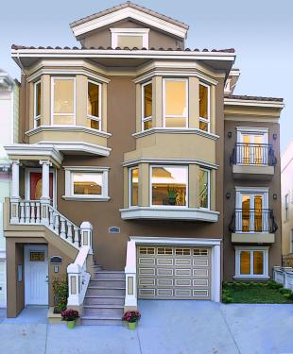
Future desire with would like to
Use would like to :
-to express future desires
Not sure/
desire
Past
Present
Future
For example:
I don’t have a house, but
I would like to buy a house
S + would + like + to + verb (bf) + compliment

Slide 3
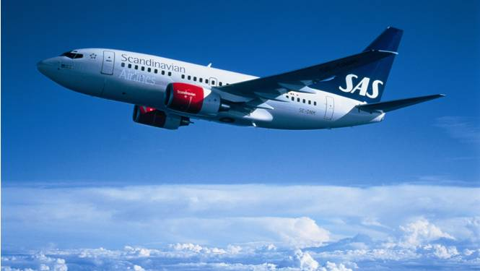
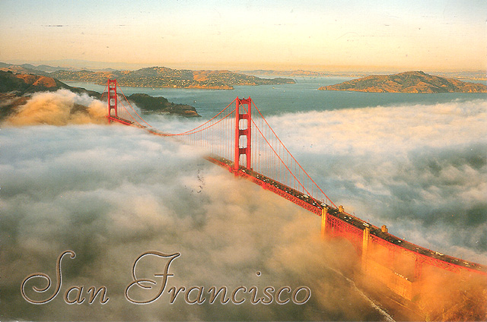
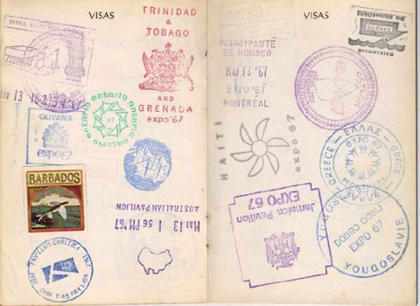
I like to travel a lot
I would like to visit San Francisco next year. (Future desire)
My passport.
(No San Francisco.)

Slide 4
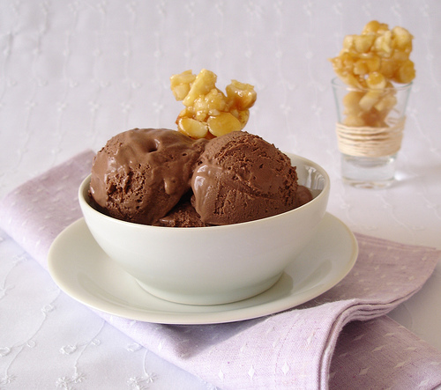
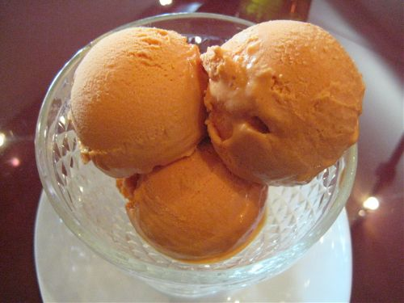
I like to eat chocolate ice cream.
But I would like to get lucuma ice cream next time I go to the store.
(for sure ? Not sure)

Slide 5
Questions with like
Wh- questions with like
What
do
you
like to do?
Wh- + do + S + like to + Verb (bf)
Yes/no questions with like
Do
you
like to study art?
Do + S + like to + Verb (bf)

Slide 6
Questions with would you like
Wh- questions with would like to
Where
would
you
like to travel?
Wh- + would + S + like to + Verb (bf)
Yes/no questions with would like to
Would
you
like to study art?
Would + S + like to + Verb (bf)

Slide 7

What would you like to change next year?
I like to paint, so I’d like to take a painting class

Slide 8
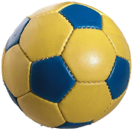
5-11 WOULD LIKE vs. LIKE
(a) I would like to play soccer.
(b) I like to play soccer.

Slide 9
(a) I would like to play soccer.
Want to
now or in the future
(b) I like to play soccer.
Enjoy
always, usually, often

Slide 10
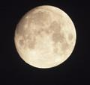
would like
likes
She _________ to visit the moon.
would like

Slide 11
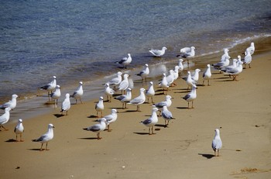
would like
like
Do you ______ to go to the beach?
like

Slide 12
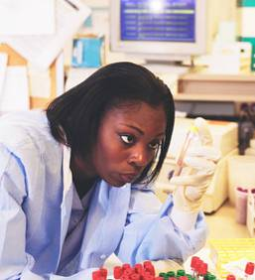
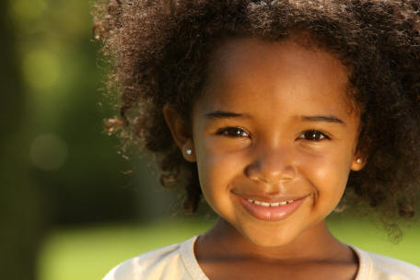
would like
like
Someday, I __________ to be a scientist.
would like

Slide 13
Write sentences about yourself. Use the following topics
your free time:
In my free time I like to take pictures.
Later this year, I would like to take a photography class in my free time.
2. After graduation:
After I graduate from my Chinese Class, I would like to travel to China.

Slide 14
you / would / What / Christmas? / like for
to play / likes / piano. / the / Karen
To / Italy. / visit / like / Mike / would
homework. / to do / like / She / her / doesn't
you / to do / homework. / your / would like / I
would / move to / Paris. / to / like / They
football / very / like / playing / We / much.
Why / don't / oysters? / like / you
Jazz / to listen / like / I / music. / to

Slide 15
I ________to have a car.
I ________ lions and tigers very much.
She ________ to play tennis this weekend.
I ________ to eat a pizza tonight.
They ________ to buy a house.
My mother ________ a new dress to go to Paul's birthday.
I don't________ your tee-shirt, it's terrible!
My son________ a video game for his birthday.
Mike ________ children very much.
Ann ________ to work for this company.
You ________ to dance, don't you?

Slide 16
Write 3 true sentences and 2 false sentences using like to and would like to
I like to cook desserts.
I like to learn languages.
I would like to visit Iquitos.
I like to swim in the ocean.
I would like to have 3 children.

